Slide 1
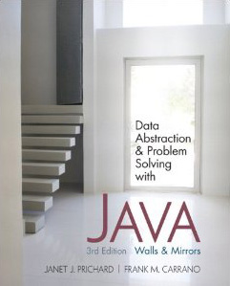
Chapter 8
Queues
© 2011 Pearson Addison-Wesley. All rights reserved
8 A-<number>

Slide 2
The Abstract Data Type Queue
A queue
  New items enter at the back, or rear, of the queue
  Items leave from the front of the queue
  First-in, first-out (FIFO) property
    The first item inserted into a queue is the first item to leave
© 2011 Pearson Addison-Wesley. All rights reserved
8 A-<number>

Slide 3
The Abstract Data Type Queue
ADT queue operations
  Create an empty queue
  Determine whether a queue is empty
  Add a new item to the queue
  Remove from the queue the item that was added earliest
  Remove all the items from the queue
  Retrieve from the queue the item that was added earliest
© 2011 Pearson Addison-Wesley. All rights reserved
8 A-<number>

Slide 4
The Abstract Data Type Queue
Queues
  Are appropriate for many real-world situations
    Example: A line to buy a movie ticket
  Have applications in computer science
    Example: A request to print a document
A simulation
  A study to see how to reduce the wait involved in an application
© 2011 Pearson Addison-Wesley. All rights reserved
8 A-<number>

Slide 5
The Abstract Data Type Queue
Pseudocode for the ADT queue operations
  createQueue()
  // Creates an empty queue.
  isEmpty()
  // Determines whether a queue is empty
  enqueue(newItem) throws QueueException
  // Adds newItem at the back of a queue. Throws
  // QueueException if the operation is not
  // successful
© 2011 Pearson Addison-Wesley. All rights reserved
8 A-<number>

Slide 6
The Abstract Data Type Queue
Pseudocode for the ADT queue operations (Continued)
  dequeue() throws QueueException
  // Retrieves and removes the front of a queue.
  // Throws QueueException if the operation is
  // not successful.
  dequeueAll()
  // Removes all items from a queue
  peek() throws QueueException
  // Retrieves the front of a queue. Throws
  // QueueException if the retrieval is not
  // successful
© 2011 Pearson Addison-Wesley. All rights reserved
8 A-<number>

Slide 7
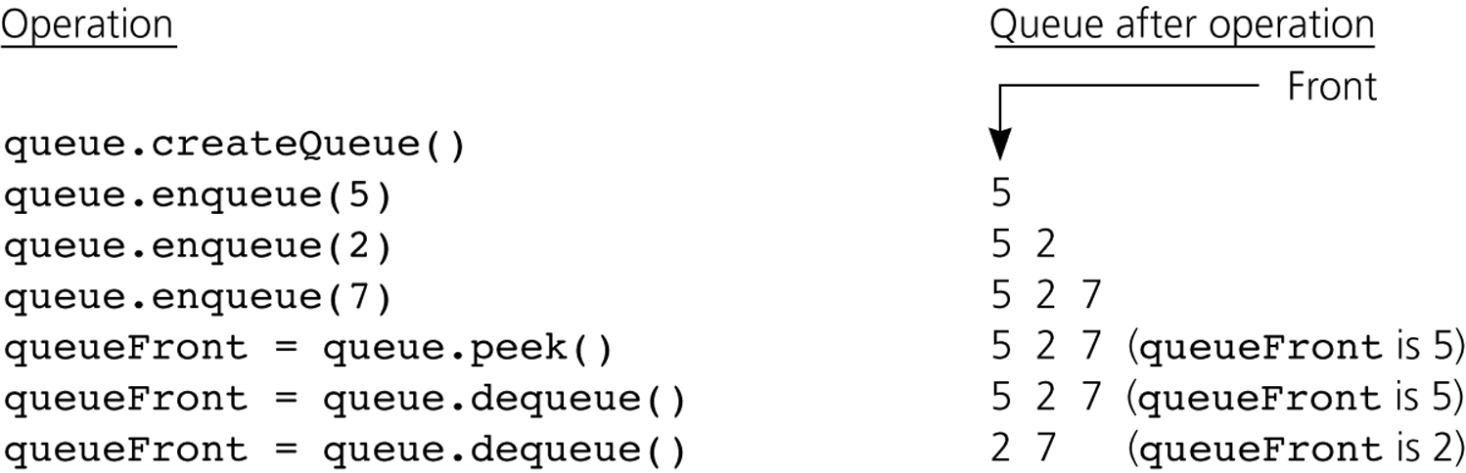
The Abstract Data Type Queue
Figure 8-2
Some queue operations
© 2011 Pearson Addison-Wesley. All rights reserved
8 A-<number>

Slide 8
Simple Applications of the ADT Queue: Reading a String of Characters
A queue can retain characters in the order in which they are typed
  queue.createQueue()
  while (not end of line) {
  Read a new character ch
  queue.enqueue(ch)
  }
Once the characters are in a queue, the system can process them as necessary
© 2011 Pearson Addison-Wesley. All rights reserved
8 A-<number>

Slide 9
Recognizing Palindromes
A palindrome
  A string of characters that reads the same from left to right as its does from right to left
To recognize a palindrome, a queue can be used in conjunction with a stack
  A stack can be used to reverse the order of occurrences
  A queue can be used to preserve the order of occurrences
© 2011 Pearson Addison-Wesley. All rights reserved
8 A-<number>

Slide 10
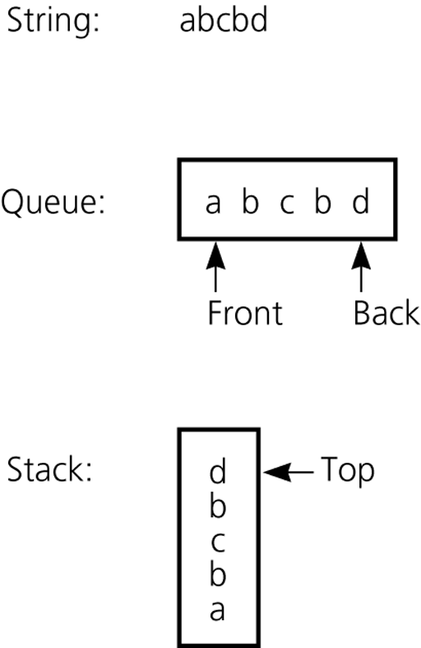
Recognizing Palindromes
A nonrecursive recognition algorithm for palindromes
  As you traverse the character string from left to right, insert each character into both a queue and a stack
  Compare the characters at the front of the queue and the top of the stack
Figure 8-3
The results of inserting a string into both a queue and a stack
© 2011 Pearson Addison-Wesley. All rights reserved
8 A-<number>

Slide 11
Implementations of the ADT Queue
A queue can have either
  An array-based implementation
  A reference-based implementation
© 2011 Pearson Addison-Wesley. All rights reserved
8 A-<number>

Slide 12
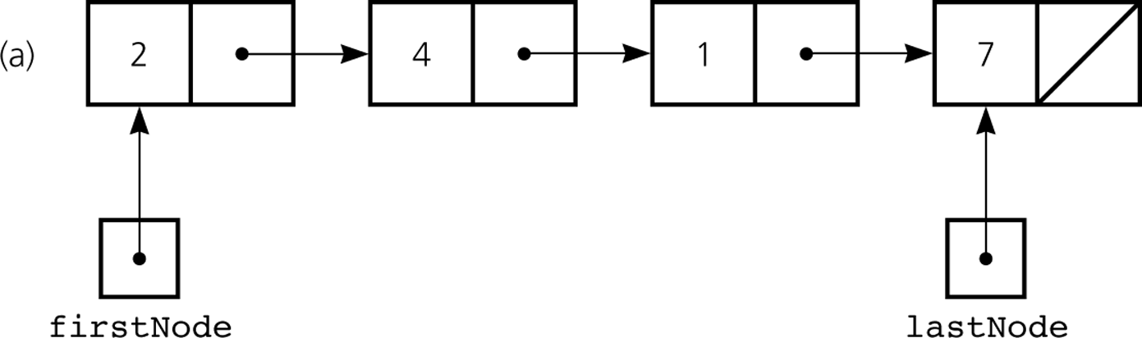
A Reference-Based Implementation
Possible implementations of a queue
  A linear linked list with two external references
    A reference to the front
    A reference to the back
Figure 8-4a
A reference-based implementation of a queue: a) a linear linked list with two external references
© 2011 Pearson Addison-Wesley. All rights reserved
8 A-<number>

Slide 13
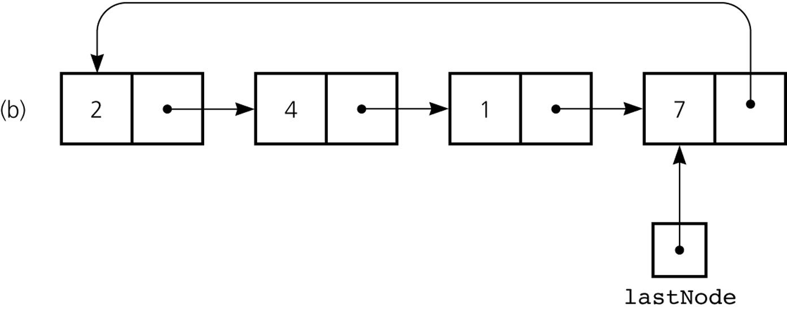
A Reference-Based Implementation
Possible implementations of a queue (Continued)
  A circular linked list with one external reference
    A reference to the back
Figure 8-4b
A reference-based implementation of a queue: b) a circular linear linked list with one external reference
© 2011 Pearson Addison-Wesley. All rights reserved
8 A-<number>

Slide 14
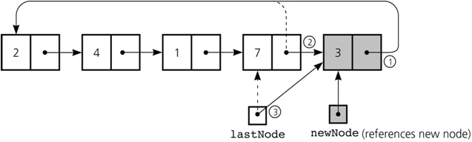
A Reference-Based Implementation
newNode.next = lastNode.next;
lastNode.next = newNode;
lastNode = newNode;
Figure 8-5
Inserting an item into a nonempty queue
© 2011 Pearson Addison-Wesley. All rights reserved
8 A-<number>

Slide 15
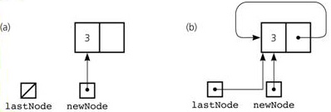
A Reference-Based Implementation
newNode.next = newNode;
lastNode = newNode;
Figure 8-6
Inserting an item into an empty queue: a) before insertion; b) after insertion
© 2011 Pearson Addison-Wesley. All rights reserved
8 A-<number>

Slide 16
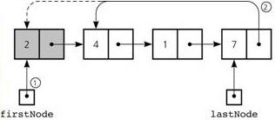
A Reference-Based Implementation
1. firstNode = lastNode.next;
2. lastNode.next = firstNode.next;
Figure 8-7
Deleting an item from a queue of more than one item
© 2011 Pearson Addison-Wesley. All rights reserved
8 A-<number>

Slide 17
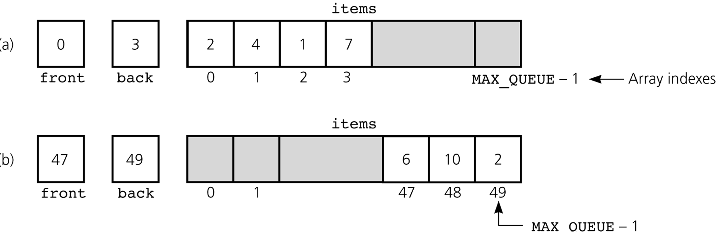
An Array-Based Implementation
Figure 8-8
a) A naive array-based implementation of a queue; b) rightward drift can cause the queue to appear full
© 2011 Pearson Addison-Wesley. All rights reserved
8 A-<number>

Slide 18
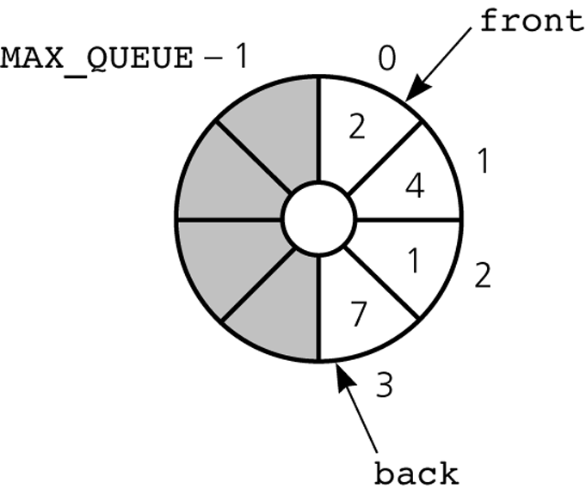
An Array-Based Implementation
A circular array eliminates the problem of rightward drift
Figure 8-9
A circular implementation of a queue
© 2011 Pearson Addison-Wesley. All rights reserved
8 A-<number>

Slide 19
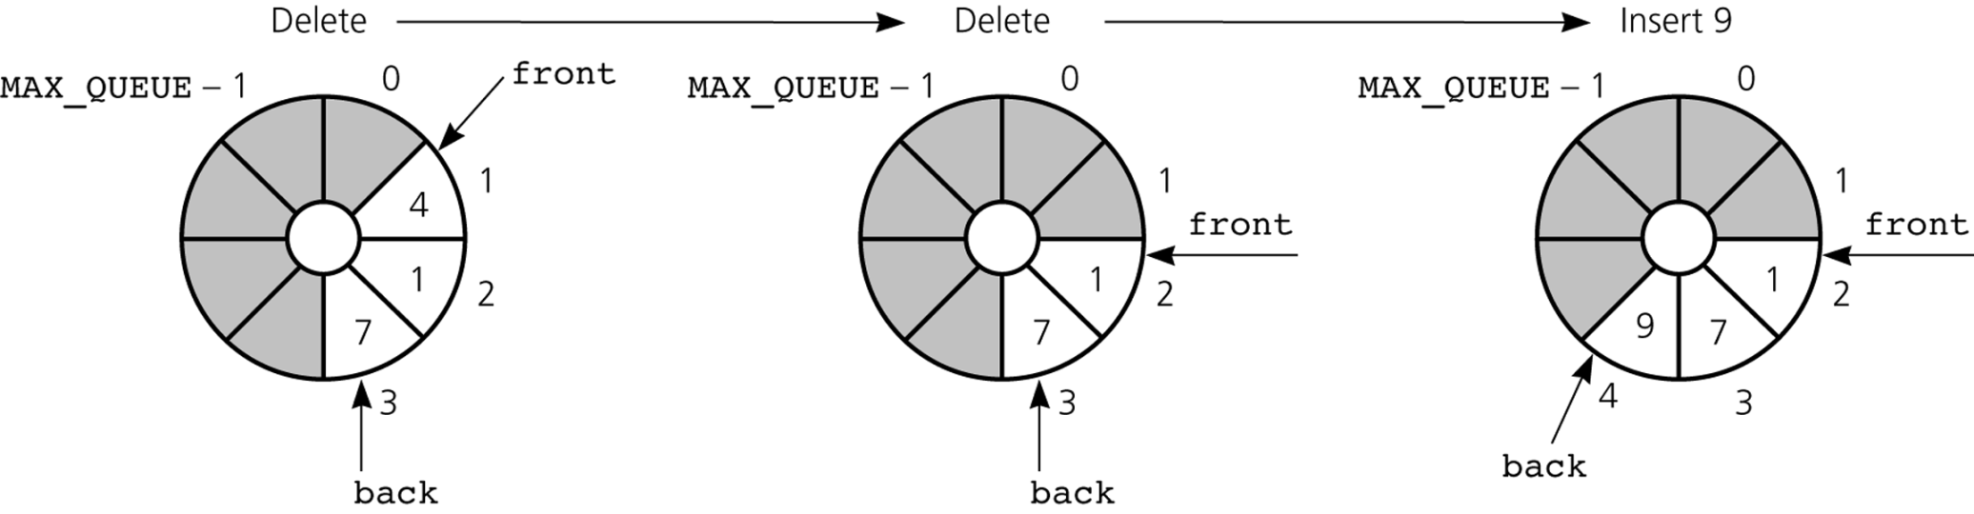
An Array-Based Implementation
Figure 8-10
The effect of some operations of the queue in Figure 8-8
© 2011 Pearson Addison-Wesley. All rights reserved
8 A-<number>

Slide 20
An Array-Based Implementation
A problem with the circular array implementation
  front and back cannot be used to distinguish between queue-full and queue-empty conditions
© 2011 Pearson Addison-Wesley. All rights reserved
8 A-<number>

Slide 21
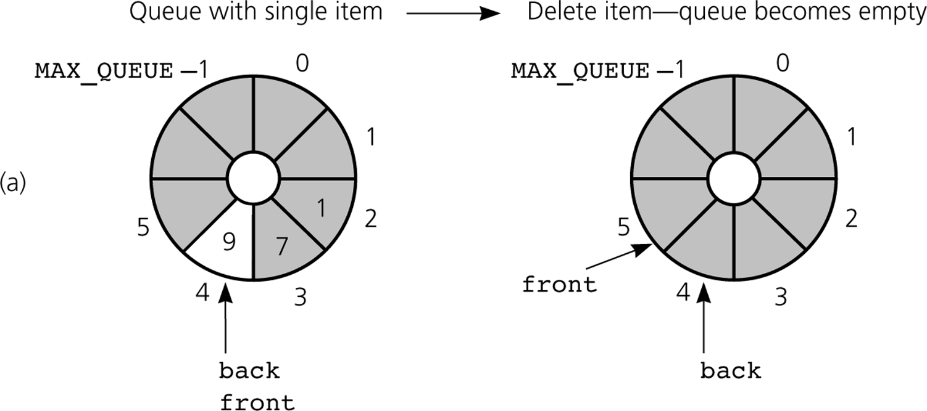
An Array-Based Implementation
Figure 8-11a
a) front passes back when the queue becomes empty
© 2011 Pearson Addison-Wesley. All rights reserved
8 A-<number>

Slide 22
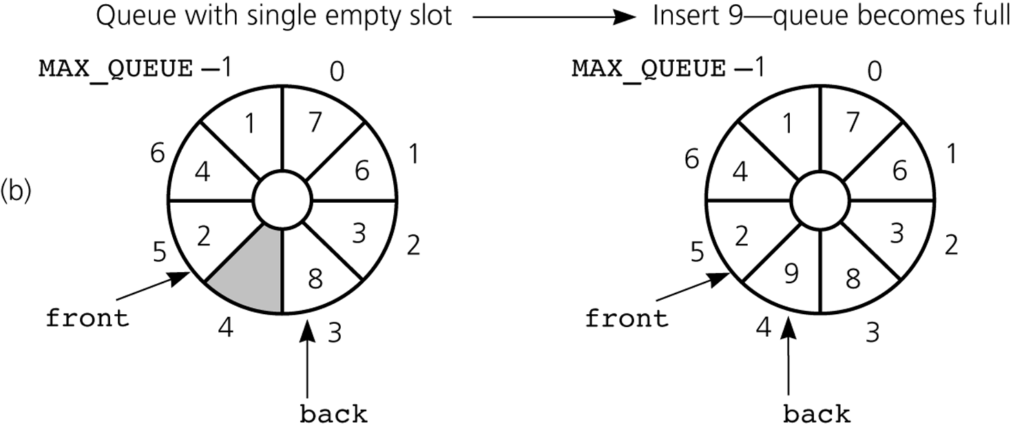
An Array-Based Implementation
Figure 8-11b
b) back catches up to front when the queue becomes full
© 2011 Pearson Addison-Wesley. All rights reserved
8 A-<number>

Slide 23
An Array-Based Implementation
To detect queue-full and queue-empty conditions
  Keep a count of the queue items
To initialize the queue, set
  front to 0
  back to MAX_QUEUE – 1
  count to 0
© 2011 Pearson Addison-Wesley. All rights reserved
8 A-<number>

Slide 24
An Array-Based Implementation
Inserting into a queue
  back = (back+1) % MAX_QUEUE;
  items[back] = newItem;
  ++count;
Deleting from a queue
  front = (front+1) % MAX_QUEUE;
  --count;
© 2011 Pearson Addison-Wesley. All rights reserved
8 A-<number>

Slide 25
An Array-Based Implementation
Variations of the array-based implementation
  Use a flag full to distinguish between the full and empty conditions
  Declare MAX_QUEUE + 1 locations for the array items, but use only MAX_QUEUE of them for queue items
© 2011 Pearson Addison-Wesley. All rights reserved
8 A-<number>

Slide 26
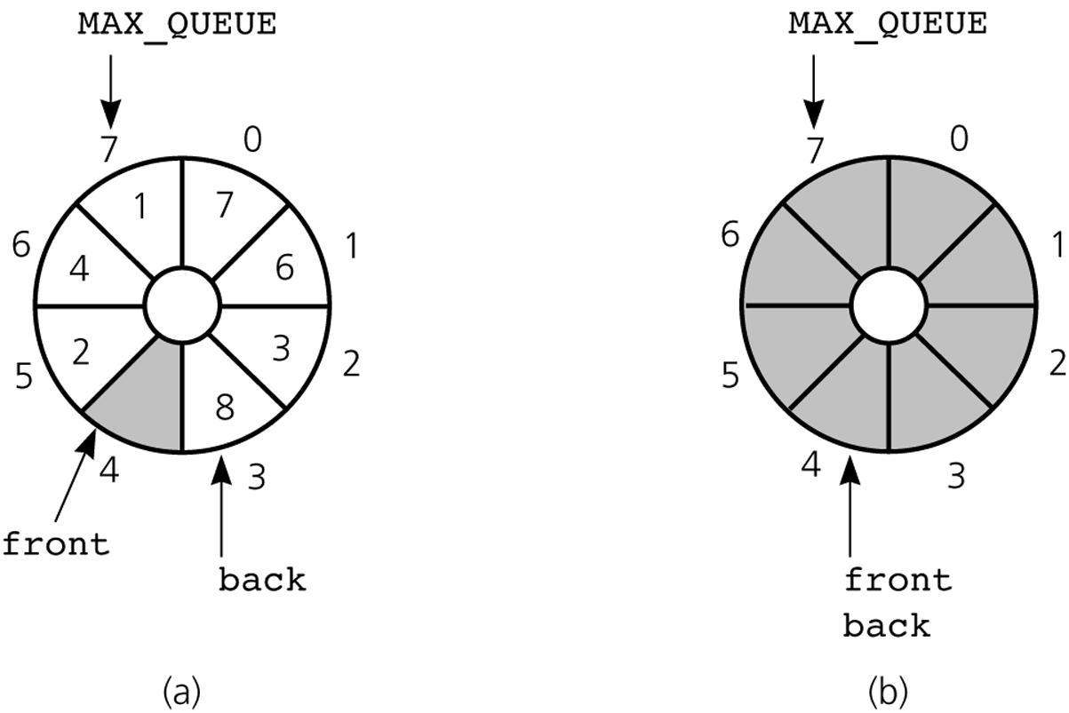
An Array-Based Implementation
Figure 8-12
A more efficient circular implementation: a) a full queue; b) an empty queue
© 2011 Pearson Addison-Wesley. All rights reserved
8 A-<number>

Slide 27
Please open file carrano_ppt08_B.ppt
to continue viewing chapter 8.
© 2011 Pearson Addison-Wesley. All rights reserved
8 A-<number>

